Slide 1


Edmonton Oilers Performance Analysis
DSC 680 Term Project
Sam Kluthe
Notes:
This presentation summarizes my term project analyzing Edmonton Oilers performance using historical game-level data. The focus is on how travel, rest, and recent performance relate to win probability.

Slide 2
Project Overview
Analyzes historical Edmonton Oilers game data
Examines travel, rest, and recent performance effects
Applies exploratory analysis and logistic regression
Notes:
This project looks beyond simple wins and losses to examine contextual factors such as scheduling and travel. The goal is to understand whether these factors meaningfully influence game outcomes.

Slide 3
Business Problem
Small performance factors can influence season outcomes
Travel fatigue and scheduling may impact win probability
Analytics can support coaching and strategic decisions
Notes:
Professional hockey is a competitive environment where small edges matter. This analysis explores whether measurable factors like travel fatigue and rest can support better strategic decision-making.

Slide 4
Data and Feature Engineering
Historical game-level Oilers data
Home vs away indicator
Days of rest and back-to-back games
Single-game and accumulated road-trip travel distance
Rolling 10-game win percentage
Notes:
The dataset was engineered to include home and away indicators, rest days, back-to-back games, and both single-game and cumulative travel distance. Performance momentum was captured using rolling win percentages.

Slide 5
Methods
Exploratory visual analysis
Correlation and win-rate comparisons
Logistic regression for win probability
Notes:
Exploratory visual analysis was used to identify patterns not visible through correlation alone. A logistic regression model was then applied to estimate win probability.

Slide 6
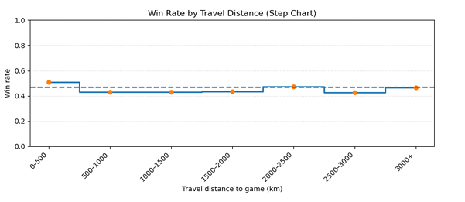
Win Rate by Travel Distance
Single-game travel distance shows minimal impact
Win rates remain stable across distance bins
Explains weak linear correlations
Notes:
This chart shows that single-game travel distance has little effect on win rates. This helps explain why simple correlations between travel distance and wins appear weak.

Slide 7
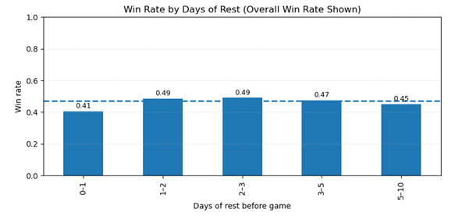
Win Rate by Days of Rest
Lower win rates on zero or one day of rest
Performance improves with moderate rest
Supports back-to-back game indicator
Notes:
Win rates are lowest when games are played with little or no rest. Performance improves with moderate rest, supporting the inclusion of a back-to-back game indicator. Peak rest is 1-3 days anything longer the win percentage drops.

Slide 8
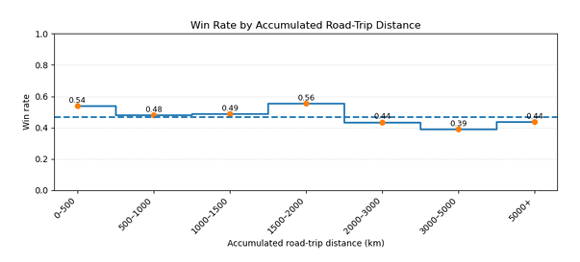
Accumulated Road-Trip Distance
Win rates decline as cumulative distance increases
Fatigue appears over extended road trips
Effects are context-dependent
Notes:
Cumulative travel distance across a road trip shows a clearer pattern than single-game travel. Fatigue appears to build over time rather than from one long trip.

Slide 9
Model Results
Home-ice advantage is a positive predictor
Recent performance is the strongest predictor
Travel variables are weaker standalone predictors
Notes:
The model results show that home-ice advantage and recent performance are the strongest predictors of winning. Travel and rest variables contribute context but are weaker standalone predictors, highlighting the importance of momentum over logistical factors.

Slide 10
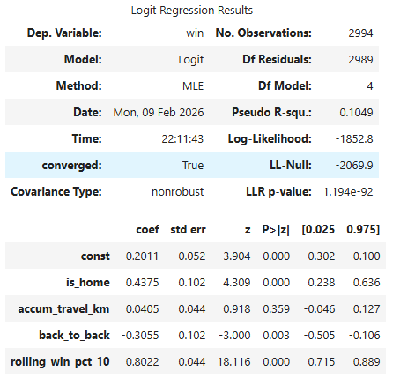
Model Results
Notes:
Intercept (−0.20): With all predictors at zero, the baseline probability of winning is slightly below fifty percent.
Home game (+0.44): Playing at home significantly increases the odds of winning, confirming a strong home-ice advantage.
Accumulated travel distance (+0.04): The coefficient is small and not statistically significant, suggesting cumulative travel alone does not consistently affect win probability.
Back-to-back games (−0.31): Playing without rest significantly reduces the odds of winning, highlighting the impact of fatigue.
Rolling 10-game win percentage (+0.80): Recent performance is the strongest predictor, showing that short-term momentum greatly increases the likelihood of winning.
Rolling 10-game win percentage (p < .001): Recent performance is extremely significant, making it the most reliable predictor in the model.

Slide 11
Ethical Considerations
Uses only publicly available, non-personal data
Avoids overstatement of predictive power
Emphasizes responsible interpretation
Notes:
This analysis uses only publicly available, non-personal data. Care was taken to avoid overstating predictive power and to communicate results responsibly. Not to be used for gambling or illegal purposes.

Slide 12
Limitations and Future Work
No player-level variables included
League changes may affect comparability
Future work could add opponent strength and player metrics
Notes:
Key limitations include the absence of player-level variables and changes in league structure over time. Future work could incorporate opponent strength, injuries, and advanced metrics.

Slide 13
Conclusion
Contextual factors matter but are secondary
Recent performance drives win probability
Visual analysis complements modeling
Notes:
In conclusion, contextual factors like travel and rest matter, but recent team performance drives outcomes most strongly. Combining visualization and modeling provides a clearer understanding than either approach alone.

Slide 14
Conclusion
What was the main goal of this analysis?
Why look at travel and rest instead of just wins and losses?
Why didn’t the correlation numbers look very strong?
Why did you focus on total road-trip travel instead of one long trip?
What does “recent performance” mean in this project?
Why do back-to-back games matter?
What factor seemed to matter most for winning?
Why didn’t travel distance alone have a big impact in the model?
What are the limits of using data like this to explain sports performance?
Are there any ethical concerns when using sports data to make decisions?
Notes:
In conclusion, contextual factors like travel and rest matter, but recent team performance driveWhat was the main goal of this analysis? To identify which contextual and performance factors are most strongly associated with winning games.
Why look at travel and rest instead of just wins and losses? Because wins and losses alone do not explain the conditions under which performance occurs.
Why didn’t the correlation numbers look very strong? Because many relationships are nonlinear and context-dependent, which simple correlation does not capture well.
Why did you focus on total road-trip travel instead of one long trip? Because fatigue is more likely to accumulate over multiple games than from a single long flight.
What does “recent performance” mean in this project? It refers to the team’s rolling win percentage over the previous ten games.
Why do back-to-back games matter? They limit recovery time and are associated with lower win probability.
What factor seemed to matter most for winning? Recent performance was the strongest and most consistent predictor.
Why didn’t travel distance alone have a big impact in the model? Because travel effects are indirect and often absorbed by rest, scheduling, and momentum.
What are the limits of using data like this to explain sports performance? The model cannot capture player-level factors such as injuries, lineup changes, or in-game decisions.
Are there any ethical concerns when using sports data to make decisions? Yes, results should not be overinterpreted or used deterministically without acknowledging uncertainty and limitations
s outcomes most strongly. Combining visualization and modeling provides a clearer understanding than either approach alone.

